Slide 1
Software Engineering
Lesson 3 – SCRUM and Agile Teams
LO1 : Plan and tackle a small software design project as part of a team using an Agile approach.

Slide 2
Lesson Objectives
Understanding the SCRUM Framework including
Backlog Grooming
Sprint
Velocity
Technical Debt
Understanding the roles of Agile Teams within the SCRUM Framework including:
Stakeholders
Product Owner
SCRUM Master
SCRUM Development Team

Slide 3
SCRUM

Slide 4

SCRUM
What is SCRUM?

Slide 5

SCRUM
What about SCRUM?
The scrum methodology is one of the most popular agile processes in use in software organizations today due to its simplicity and flexibility
One reason for Scrum’s popularity is that it consists of only a few common sense practices that can be applied in many situations.
It is a skeleton that includes a small set of practices and predefined roles.
This also means that Scrum by itself is never enough, and that development teams have to shop in other methods (usually XP) for additional practices

Slide 6
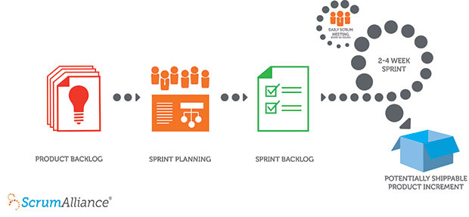
SCRUM
Structure of the SCRUM Framework :
The Scrum process involves the following steps:
Backlog Grooming
Sprint Planning
Daily Scrum
Sprint Review Meeting
Sprint Retrospective Meeting

Slide 7

SCRUM
How Does SCRUM Work?
A product owner creates a wish list of what he
would like the new system to do; this list is known as a Product Backlog.
A Backlog Grooming Session is set up between the SCRUM Team and the stakeholder to prioritize the list of work in the Product Backlog and break the list into user stories.
User stories are short, simple descriptions of a feature told from the perspective of the person who desires the new capability.
They also estimate the effort required for each user story to make Sprint Planning easier.

Slide 8
SCRUM
How Does SCRUM Work?
During Sprint Planning, the team agrees on what the team plans to achieve during the sprint –the Sprint Goal and also pulls a small chunk from the top of that wish list, a Sprint Backlog, and decides how to implement those pieces.
The team has a certain amount of time — a Sprint (usually two to four weeks) — to complete its work, but it meets each day for a Daily SCRUM Meeting to assess its progress and solve any issues.
Along the way, the Scrum Master keeps the
team focused on its goal.

Slide 9
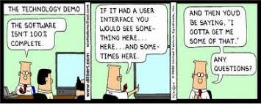
SCRUM
How Does SCRUM Work?
At the end of the sprint, a Sprint Review Meeting is set up and a Demo is held so that customers may evaluate the work that has been achieved during the Sprint. At this point, the work should be potentially shippable: ready to hand to a customer, put on a store shelf, or show to a stakeholder.
The sprint ends with a Team Retrospective Meeting to identify the things that the team is doing well; things they should start doing in order to improve; and things that are keeping them from performing at their best.

Slide 10
SCRUM
How Does SCRUM Work?
Beyond the sprint
As the next sprint begins, the team holds another Backlog Grooming Session, chooses another chunk of the product backlog, re-prioritizes it and begins working again following the activities as before.
The cycle repeats until enough items in the product backlog have been completed, the budget is depleted, or a deadline arrives.
Which of these milestones marks the end of the work is entirely specific to the project.
No matter which impetus stops work, thanks to user story prioritization, Scrum ensures that the most valuable work has been completed by the project’s end.

Slide 11
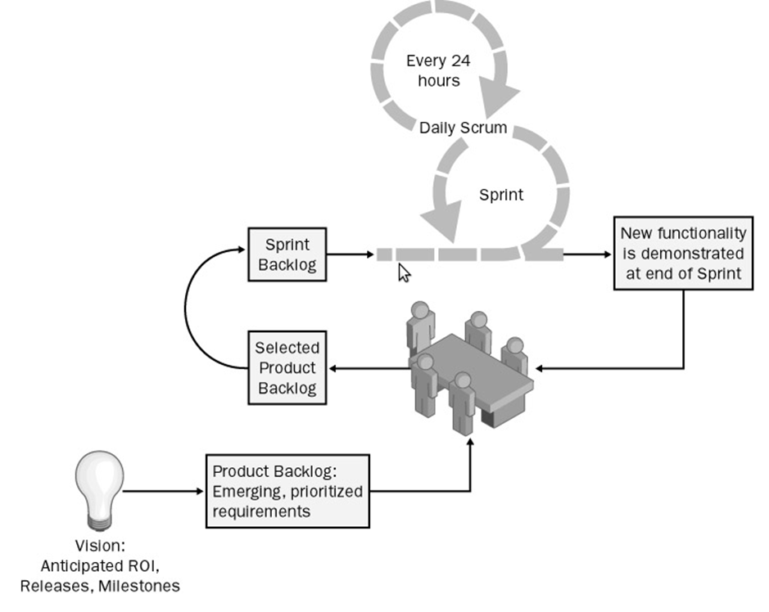
SCRUM
How Does SCRUM Work?
In short…

Slide 12
SCRUM
How Does SCRUM Work?
For more detail about how each phase of the SCRUM Framework works….
Part 1 : Introduction to SCRUM
Watch from : http://scrumtrainingseries.com/Intro_to_Scrum/Intro_to_Scrum.htm

Slide 13
SCRUM
How Does SCRUM Work?
For more detail about how each phase of the SCRUM Framework works….
Part 2 :Backlog Refinement
Watch from : http://scrumtrainingseries.com/BacklogRefinementMeeting/BacklogRefinementMeeting.htm

Slide 14
SCRUM
How Does SCRUM Work?
For more detail about how each phase of the SCRUM Framework works….
Part 3 :Sprint Planning
Watch from : http://scrumtrainingseries.com/SprintPlanningMeeting/SprintPlanningMeeting.htm

Slide 15
SCRUM
How Does SCRUM Work?
For more detail about how each phase of the SCRUM Framework works….
Part 4 :Daily Scrum Meetings
Watch from : http://scrumtrainingseries.com/DailyScrumMeeting/DailyScrumMeeting.htm

Slide 16
SCRUM
How Does SCRUM Work?
For more detail about how each phase of the SCRUM Framework works….
Part 5 :Sprint Review Meeting
Watch from : http://scrumtrainingseries.com/SprintReviewMeeting/SprintReviewMeeting.htm

Slide 17
SCRUM
How Does SCRUM Work?
For more detail about how each phase of the SCRUM Framework works….
Part 6 :Sprint Retrospective Meeting
Watch from : http://scrumtrainingseries.com/SprintRetrospectiveMeeting/SprintRetrospectiveMeeting.htm

Slide 18
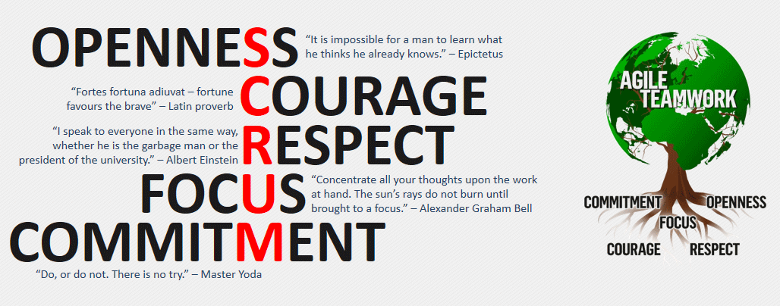
SCRUM
Values of the SCRUM Framework :

Slide 19
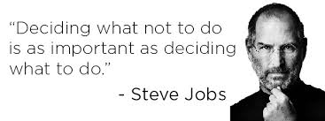
SCRUM
Values of the SCRUM Framework :
Focus
By focusing on only a few things at a time,
the team works well together and produces
excellent work; valuable items are delivered sooner.
Courage
By working as a team, developers feel supported and have more resources at their disposal; this gives them more courage to undertake greater challenges.

Slide 20

SCRUM
Values of the SCRUM Framework :
Openness
Team members work together and express how each one is doing, what's in their way, and their concerns so they can be addressed.
Commitment
Team members have great control over their
own destiny, they are more committed to success.
Respect
Sharing successes and failures, helps team members to respect each other and to help each other become worthy of respect.

Slide 21
SCRUM
Advantages of using the SCRUM Framework :
Agile scrum helps the company in saving time and money as fast moving, cutting edge developments can be quickly coded and tested using this method.
Scrum methodology enables project’s where the business requirements documentation is hard to quantify to be successfully developed.
It is a lightly controlled method which insists on frequent updating of the progress in work through regular meetings. Thus there is clear visibility of the project development.

Slide 22
SCRUM
Advantages of using the SCRUM Framework :
Due to short sprints and constant feedback, it becomes easier to cope with the changes.
Daily meetings make it possible to measure individual productivity leading to the improvement in the productivity of each of the team members.
Issues are identified well in advance through the daily meetings and hence can be resolved in speedily.
The overhead cost in terms of process and management is minimal thus leading to a quicker, cheaper result.

Slide 23
SCRUM
Drawbacks of using the SCRUM Framework :
Scrum is one of the leading causes of scope creep because unless there is a definite end date, the project management stakeholders will be tempted to keep demanding new functionality is delivered.
If a task is not well defined, estimating project costs and time will not be accurate and a single task can end up spreading over several sprints.
If the team members are not committed, the project will either never complete or fail.
It is good for small, fast moving projects as it works well only with small team.

Slide 24
SCRUM
Drawbacks of using the SCRUM Framework :
This methodology needs experienced team members only. If the team consists of people who are novices, the project cannot be completed in time.
Scrum works well when the Scrum Master trusts the team they are managing. If they practice too strict control over the team members, it can be extremely frustrating for them, leading to demoralization and the failure of the project.
If any of the team members leave during a development it can have a huge inverse effect on the project development

Slide 25
SCRUM Team

Slide 26

SCRUM Teams
The Structure of Agile Scrum Teams :
Teams are small and often chosen based on their
technical skills, depending on the project in
question. This ensures that they have knowledge
to bring to the team thus making it self-sufficient.
It is highly suggested that team members have exposure to a variety of roles and are familiar with more than one specific task so that they can take on roles of designers, testers and developers as required.

Slide 27
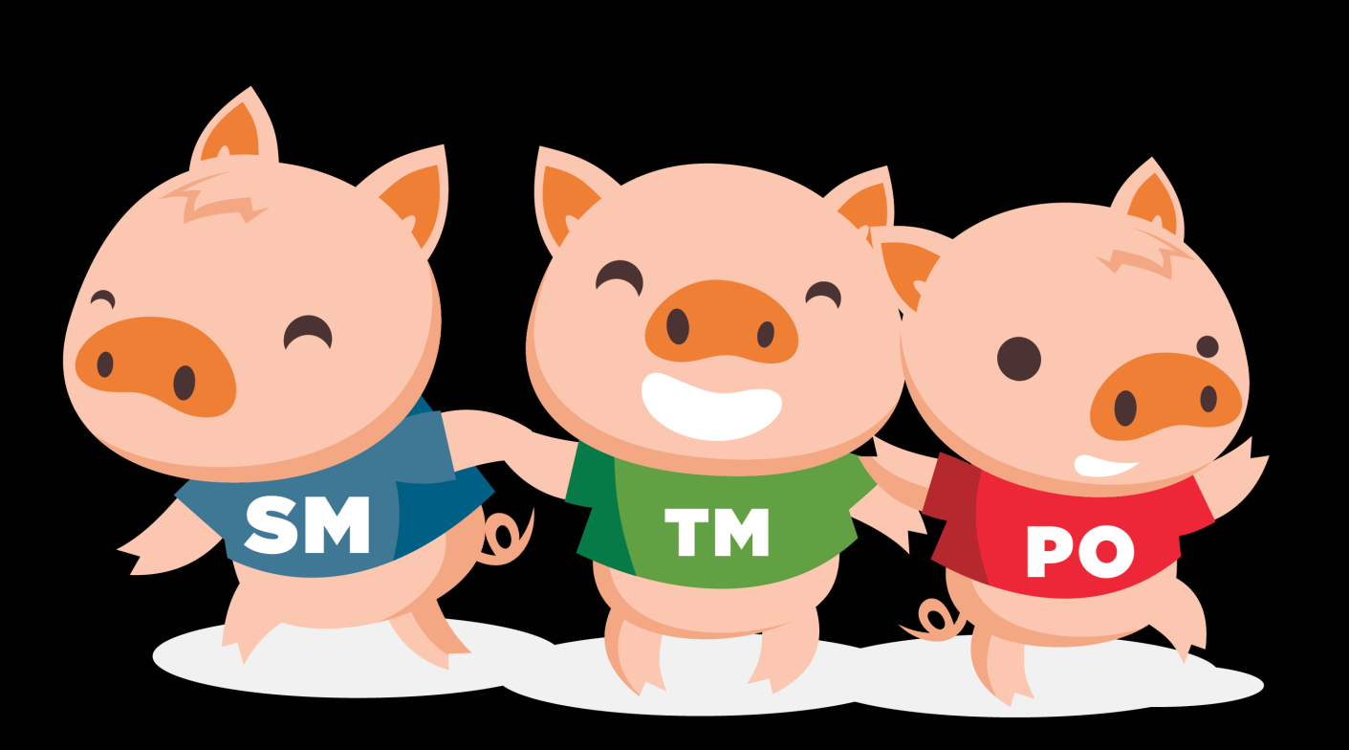
SCRUM Teams
The Structure of Agile Scrum Teams :
The 3 fundamental roles in the Scrum method of Agile Software Development:
PO – Product Owner SM – SCRUM Master TM – Team Member

Slide 28
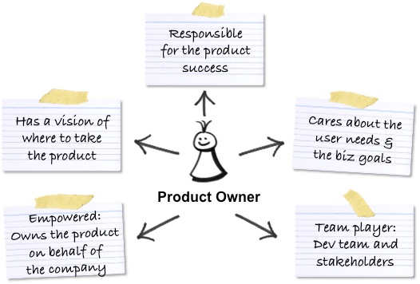
SCRUM Teams
The Product Owner
A team member whose role is that of constantly representing the stake holder during the team’s day to day operations. He has a major role in the prioritization of tasks and is responsible for maintaining constant communication channels with stake holder to report team’s work and bring back feedback.
During project execution, the product owner
is the one who is responsible for maintaining
the product backlog, bridging the gap
between the developers and other stakeholders,
managing customer expectations and managing the budget . He is also the one who takes a call on the quality of the product and if it requires any improvement.

Slide 29
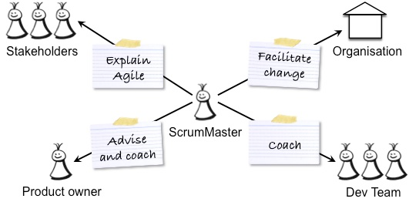
SCRUM Teams
The SCRUM Master
Responsible ensuring the overall smooth
running of the team’s operations and for
solving any sort of problem that the team
is facing while building the product.
He is responsible for guiding the team, building a trustworthy environment within the team, facilitating discussions – negotiation – communications and removing impediments and problems.
It is not necessary for him to completely understand the requirements; he must be capable enough to find solutions to situations. He has to create and maintain the best possible working condition for the team members, ensures availability of resources, and protects team from external issue so that they can meet the goals of each sprint effectively.

Slide 30
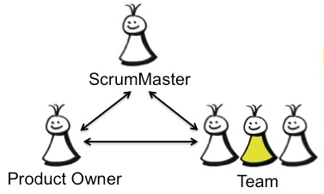
SCRUM Teams
The SCRUM Development Team
A small, cross-functional team consisting of developers, business analysts, testers that is responsible for developing the product. The team works together while building the application to achieve the targets associated with a specific sprint.
Team members are also responsible for identifying the complexity of the tasks and allocating efforts (in number of hours / days) to these tasks.
They are responsible for communicating the
daily status of project and issues that they
are facing to the scrum masters and giving a
demo of tasks completed by them to product
owners during sprint reviews.

Slide 31

SCRUM Teams
The Role of SCRUM Team Members during Backlog Grooming
Who Attends?
Everyone!
The Development Team, Product Owner, and Scrum Master.
What Happens?
Everyone helps prepare the Product Backlog by discussing the top items on the product backlog, adding new user stories or splitting up existing user stories which are too large and complex into smaller user stories. The effort for existing stories is estimated.
The Product Owner is responsible to have a vision of what he or she wishes to build, and convey that vision to the scrum team
The Team prepares for the Sprint Planning – the Development Team get the chance to ask questions about how the user stories should be tackled and the Product Owner is given a chance to arrive at answers before the Sprint Planning.

Slide 32

SCRUM Teams
The Role of SCRUM Team Members during Sprint Planning Meeting
Who Attends?
The Product Owner, Scrum Master and
the entire Scrum Team. At times, outside
stakeholders may attend by invitation of the team.
What Happens?
The Product Owner describes the highest priority features to the team.
The Team asks questions so that high-level user stories can be expanded into more detailed tasks of the sprint backlog.

Slide 33

SCRUM Teams
The Role of SCRUM Team Members during Sprints
Who Attends?
Everyone is expected to participate and commit!
The Development Team, Product Owner, and Scrum Master.
What Happens?
All team members must meet daily for SCUM Meetings to adjourn on progress and discuss any issues and find a solution to them as a team.
The Team must produce a coded, tested and usable piece of software according to the user stories defined in the sprint backlog.
The Scrum Master acts as a coach and protector for the team, helping the team do the best work it possibly can.

Slide 34

SCRUM Teams
The Effect of SCRUM Team Members on Velocity
Velocity is the measure of how fast the SCRUM Team is going.
This depends on :
How much functionality a team delivers in a sprint.
Team's ability to turns ideas into new functionality in a sprint.
Velocity can be decreased by
Lack of strong product owners who lacks a clear product vision and focus.
Lack of a SCRUM Master with strong project management skills
Lack of a dedicated and committed SCRUM Team
Lack of experience in describing and designing user stories within the SCRUM Team and Product Owner

Slide 35
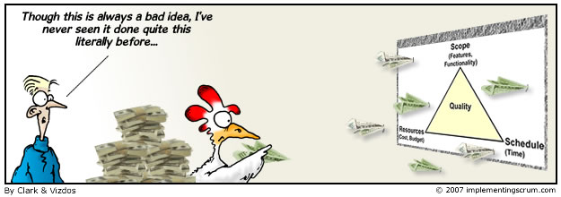
SCRUM Teams
The Role of SCRUM Team Members during Sprint Reviews
Who Attends?
The Product Owner, the Scrum Team, the Scrum Master, customers and even management developers from other projects!
What Happens?
The Scrum Team shows what they accomplished during the sprint.
All stakeholders help to assess the project against the sprint goal determined during the sprint planning meeting to see if these have been achieved.

Slide 36
SCRUM Teams
The Role of SCRUM Team Members during Team Retrospectives
Who Attends?
The Product Owner, the Scrum Team and the Scrum Master.
What Happens?
Each team member is asked to identify specific things that the team should:
Start doing
Stop doing
Continue doing
The Scrum Master should lead, control and facilitate this sprint retrospective.

Slide 37
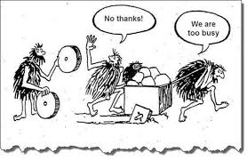
SCRUM Teams
The Effect of SCRUM Team Members on Technical Debt
Technical Debt is work that needs to be done before a particular job can be considered complete or proper. If the debt is not repaid, then it will keep on accumulating interest, making it harder and costlier to implement changes and maintenance.
Technical Debt manifest itself through high defect rates, reduced team velocity, poor code maintenance and low productivity.

Slide 38
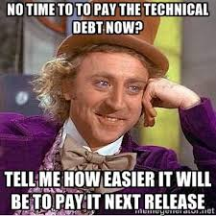
SCRUM Teams
The Effect of SCRUM Team Members on Technical Debt
This is caused by the development team cutting corners due :
Sheer laziness.
Increased Business Pressure to meet deadlines
Lack of skill in creating a good design and writing elegant code.
Lack of proper testing, resorting to quick and risky Band-Aids to fix bugs
Lack of collaboration and knowledge sharing between team members – little mentoring for juniors
Lack of alignment to standards, making integration
of separate modules more difficult

Slide 39
End of Lesson 3
Any questions?

